Slide 1
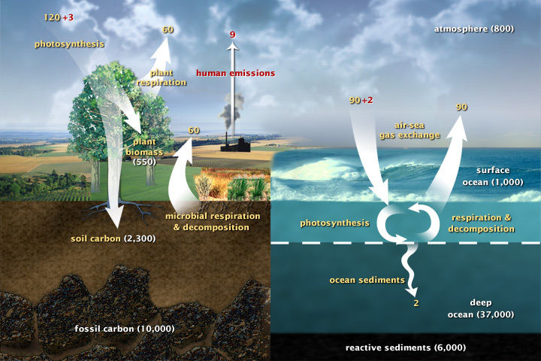
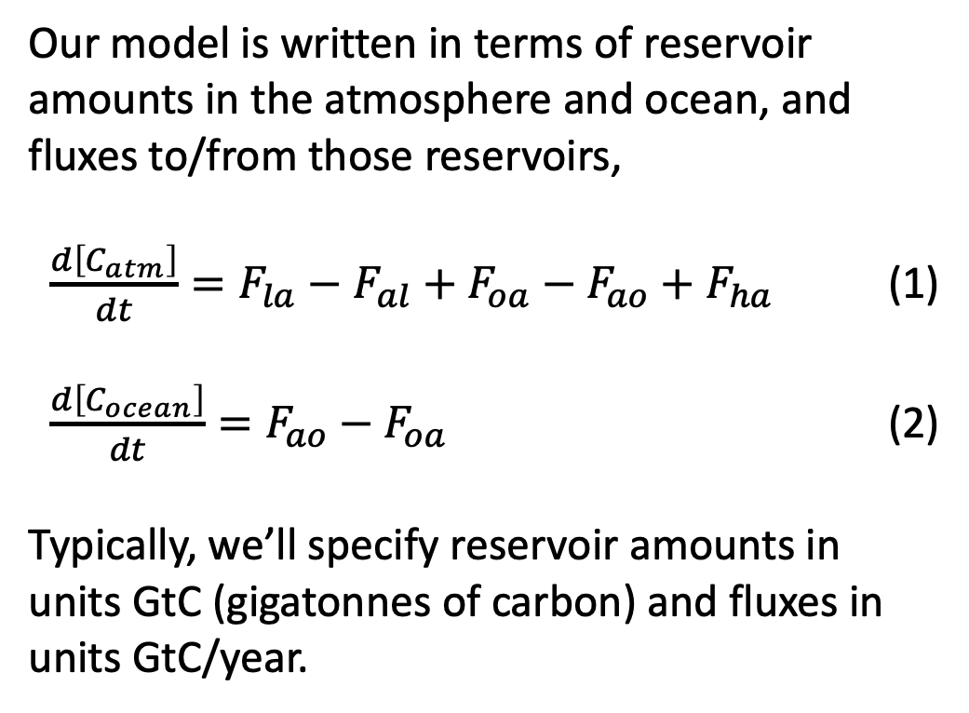
Part 1. The basic Cambio model
Our model is written in terms of reservoir amounts in the atmosphere and ocean, and fluxes to/from those reservoirs,
$\frac{d\left[C_{atm}\right]}{dt}=F_{la}−F_{al}+F_{oa}−F_{ao}+F_{ha}$ (1)
$\frac{d\left[C_{ocean}\right]}{dt}=F_{ao}−F_{oa}$ (2)
Typically, we’ll specify reservoir amounts in units GtC (gigatonnes of carbon) and fluxes in units GtC/year.

Slide 2
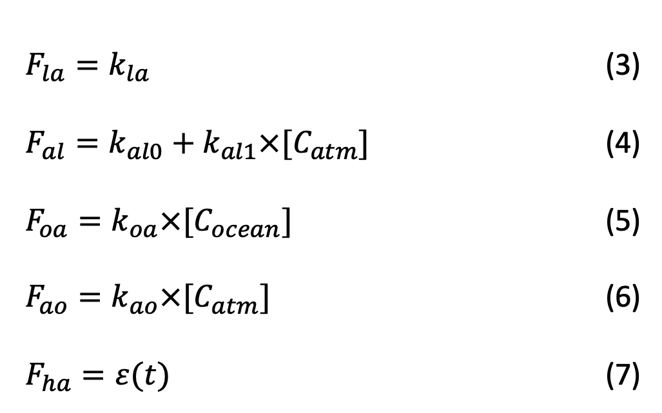
Carbon fluxes
In the simplest version of the model, Cambio 1.0, the fluxes are given by
$F_{la}=k_{la}$ (3)
$F_{al}=k_{al0}+k_{al1}×[C_{atm}]$ (4)
$F_{oa}=k_{oa}×[C_{ocean}]$ (5)
$F_{ao}=k_{ao}×[C_{atm}]$ (6)
$F_{ha}=ε(t)$ (7)

Slide 3
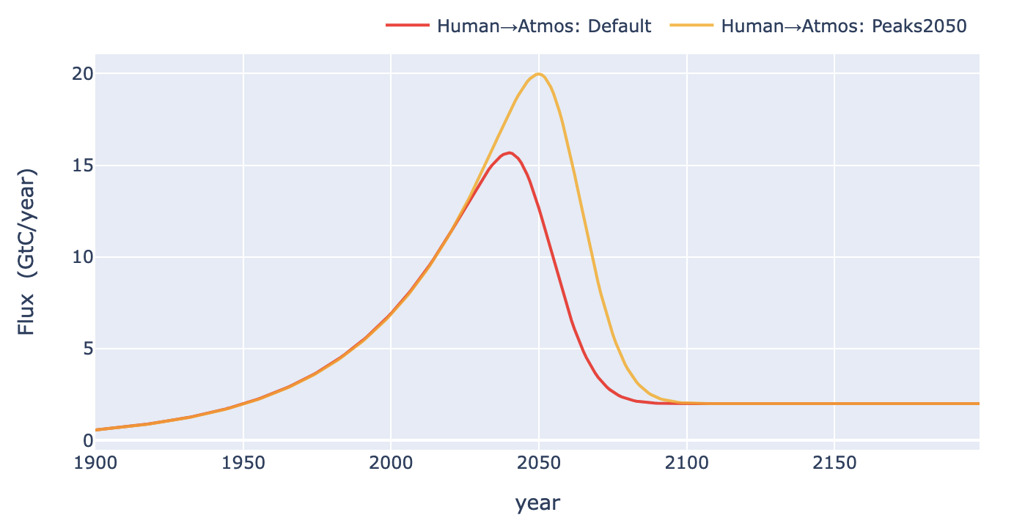
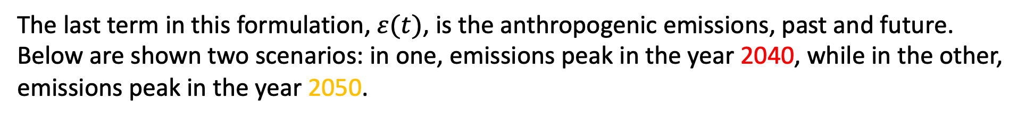
The expected anthropogenic emissions, 𝜀(𝑡)
The last term in this formulation, $ε(t)$, is the anthropogenic emissions, past and future. Below are shown two scenarios: in one, emissions peak in the year 2040, while in the other, emissions peak in the year 2050.

Slide 4
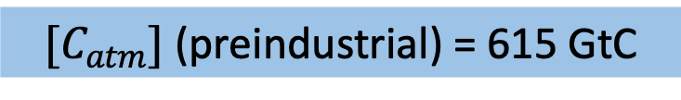
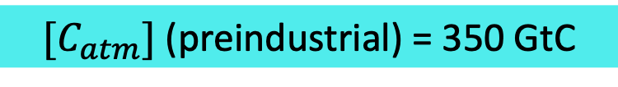
To solve for future reservoir amounts, we’ll also need to say what values we started with
$[C_{atm}]$ (preindustrial) = 615 GtC
$[C_{atm}]$ (preindustrial) = 350 GtC

Slide 5
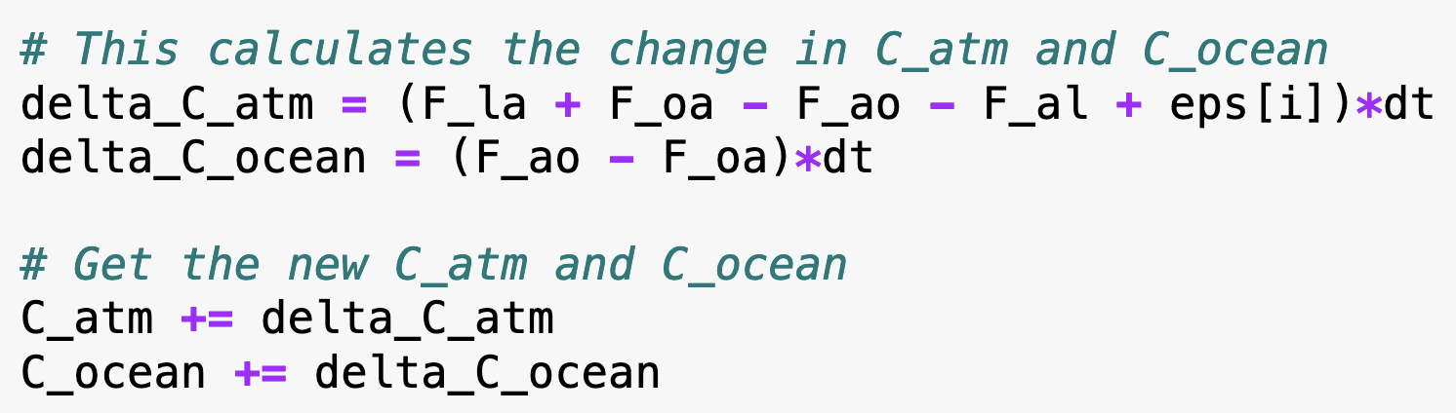
Using Euler’s method to solve for reservoir amounts over time
To solve the model numerically, we would set up a loop over time, and in the loop have these lines of code:

Slide 6
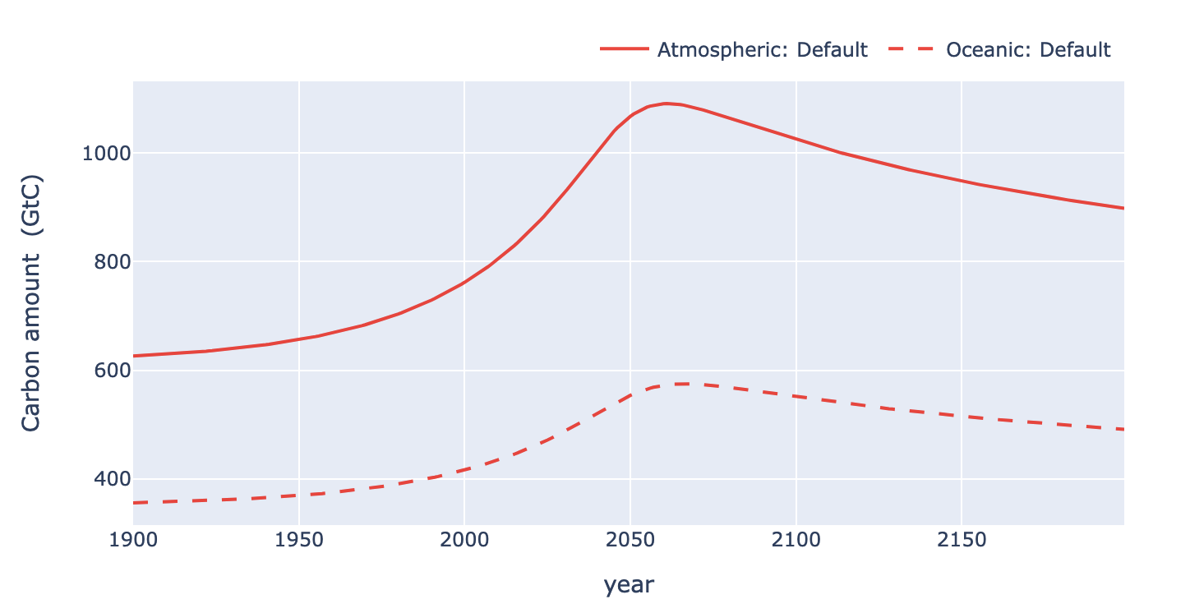
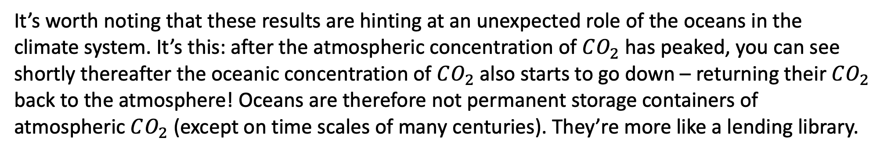
An example of what Cambio predicts: the evolution of $\left[C_{atm}\right]$ and $[C_{ocean}]$ over time
Here are Cambio-predicted carbon reservoir amounts for a scenario in which anthropogenic emissions peaked in the year 2040 (red circle).
It’s worth noting that these results are hinting at an unexpected role of the oceans in the climate system. It’s this: after the atmospheric concentration of $CO_{2}$ has peaked, you can see shortly thereafter the oceanic concentration of $CO_{2}$ also starts to go down – returning their $CO_{2}$ back to the atmosphere! Oceans are therefore not permanent storage containers of atmospheric $CO_{2}$ (except on time scales of many centuries). They’re more like a lending library.

Slide 7
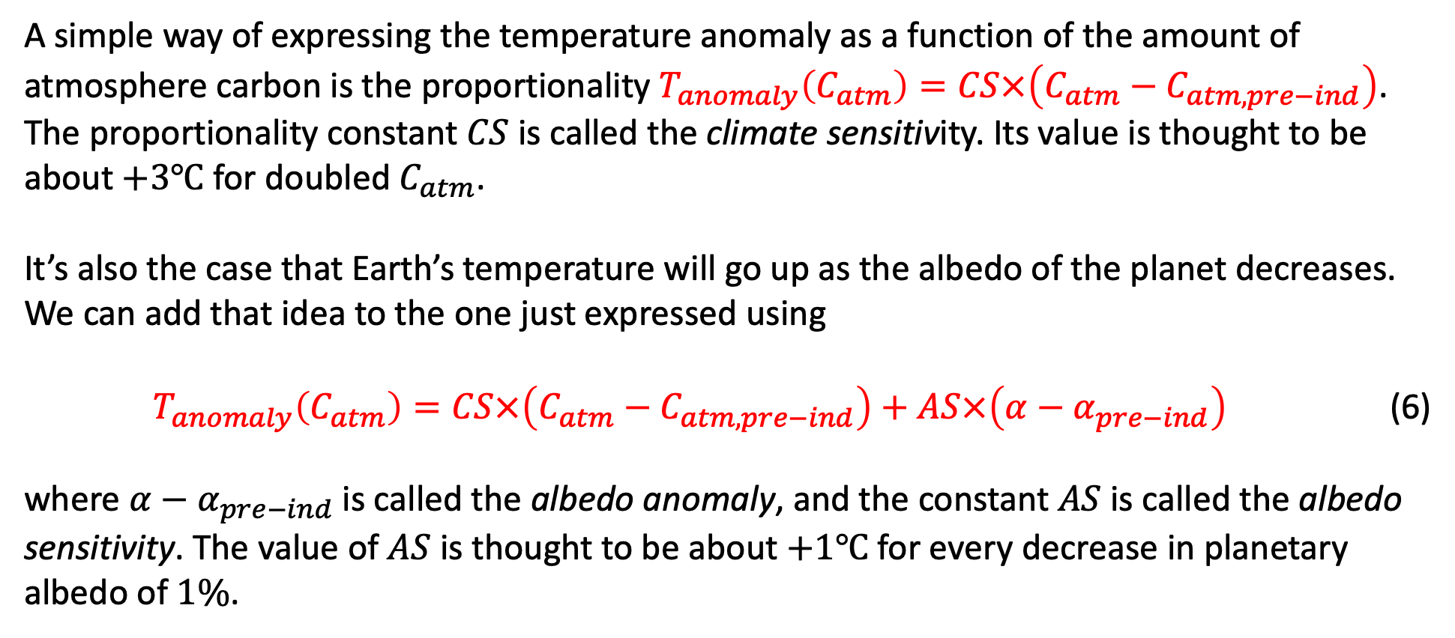
Part 2. Using our reservoir results to predict warming
A simple way of expressing the temperature anomaly as a function of the amount of atmosphere carbon is the proportionality $T_{anomaly}\left(C_{atm}\right)=CS×\left(C_{atm}−C_{atm, pre−ind}\right)$. The proportionality constant $CS$ is called the climate sensitivity. Its value is thought to be about $+3℃$ for doubled $C_{atm}$.
It’s also the case that Earth’s temperature will go up as the albedo of the planet decreases. We can add that idea to the one just expressed using
$T_{anomaly}\left(C_{atm}\right)=CS×\left(C_{atm}−C_{atm, pre−ind}\right)+AS×\left(α−α_{pre−ind}\right)$ (6)
where $α−α_{pre−ind}$is called the albedo anomaly, and the constant $AS$ is called the albedo sensitivity. The value of $AS$ is thought to be about $+1℃$ for every decrease in planetary albedo of $1\%$.

Slide 8



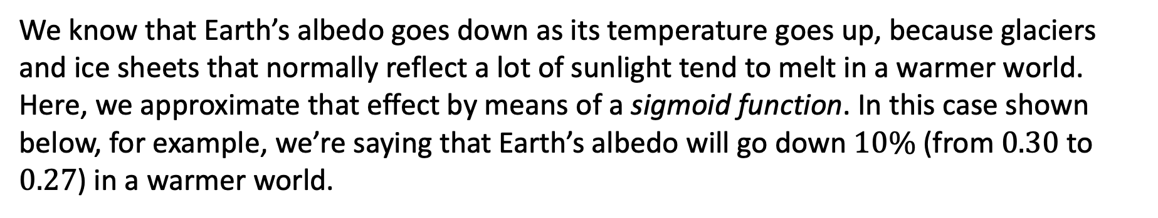



How to compute the albedo anomaly
We know that Earth’s albedo goes down as its temperature goes up, because glaciers and ice sheets that normally reflect a lot of sunlight tend to melt in a warmer world. Here, we approximate that effect by means of a sigmoid function. In this case shown below, for example, we’re saying that Earth’s albedo will go down $10\%$ (from $0.30$ to $0.27$) in a warmer world.
$$ΔT_{α,trans}$$
$$0.30$$
$$α$$
$$0.27$$
$$T_{anomaly}$$
$$T_{α,trans}$$

Slide 9
Mathematical representation of sigmoidal functions
$σ_{floor}\left(T_{anomaly}\right)=\left(1−\frac{1}{1+\exp\left(−\frac{3\left(T_{anomaly}−T_{α,trans}\right)}{ΔT_{α,trans}}\right)}\right)\left(1−f_{trans}\right)+f_{trans}$ (7)
$$ΔT_{α,trans}$$
$$0.30$$
$$α$$
$$0.27$$
$$T_{anomaly}$$
$$T_{α,trans}$$

Slide 10
A tricky aspect of this: the albedo/temperature feedback
We’ve argued, via Eq. 6, that the temperature anomaly depends on the albedo. Then we argued, via Eq. 7, that the albedo depends on the temperature anomaly! This interdependence is generically called a feedback mechanism. In the climate science literature, this is often called ice/albedo feedback. Here, we’ll use a slightly more descriptive term, the albedo/temperature feedback.
Feedbacks can be positive (self-reinforcing), or negative (self-dampening). In the case of albedo/temperature feedback, it turns out to be positive: higher temperatures -> lower albedo -> even higher temperatures.
Computationally, feedbacks generally can be solved by putting the equations into a loop, and iterating long enough that the results stop reinforcing one another. We say we iterate until the feedback converges.

Slide 11
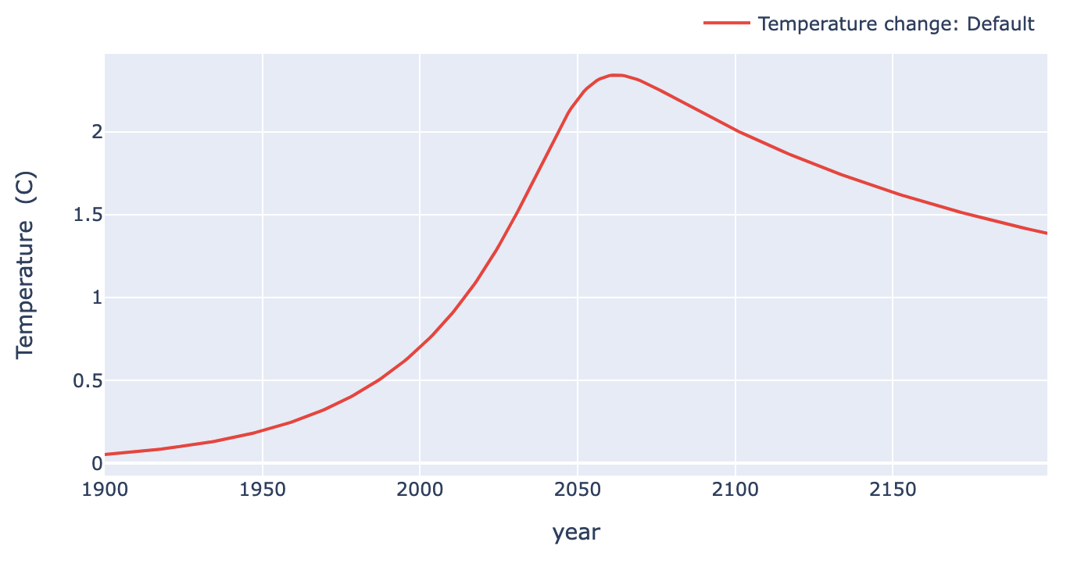
A sample calculation of Earth’s temperature anomaly with albedo/temperature feedback
Here’s what we predicted for the evolution of carbon reservoirs in the atmosphere and ocean over time:
Here’s what the equations just presented allow us to say about the resulting temperature anomaly:
A question to ponder: why does the temperature peak decades after the year of peak emission (2040)?

Slide 12

Part 3. When feedbacks involve carbon fluxes
A little more realism can be incorporated into our model by recognizing that carbon fluxes are modified according to the temperature anomaly. This is another level of feedback, beyond what we talked about in Part 2. The idea can be represented by modifying the equations defining our model, namely
$F_{la}=k_{la}$ (3’)
$F_{al}=k_{al0}+k_{al1}×[C_{atm}]×σ_{floor}\left(T_{anomaly}\right)$ (4’)
$F_{oa}=k_{oa}×[C_{ocean}]×(1+T_{anomaly} ×DC)$ (5’)
$F_{ao}=k_{ao}×[C_{atm}]$ (6’)
$F_{ha}=ε(t)$ (7’)

Slide 13


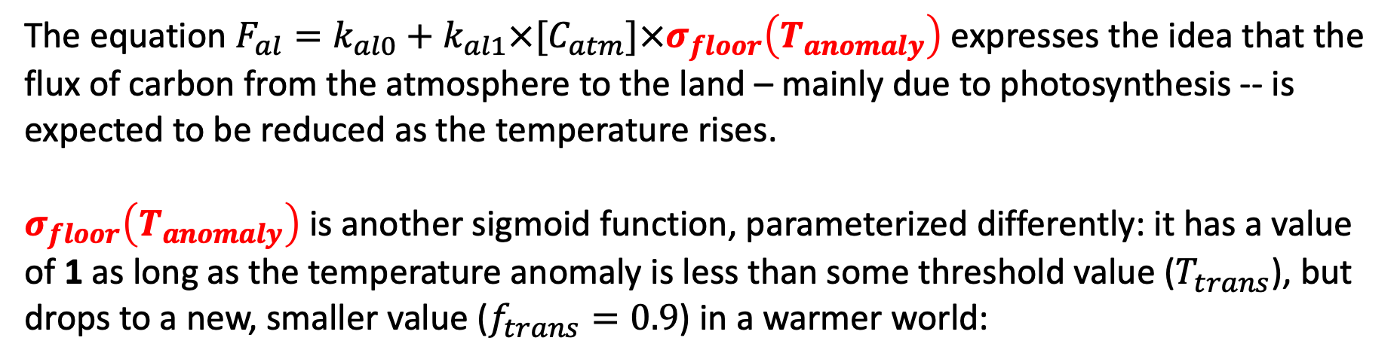



Equation 5’ represents the idea that atm-to-land flux depends on temperature
The equation $F_{al}=k_{al0}+k_{al1}×[C_{atm}]×σ_{floor}\left(T_{anomaly}\right)$ expresses the idea that the flux of carbon from the atmosphere to the land – mainly due to photosynthesis -- is expected to be reduced as the temperature rises.
$σ_{floor}\left(T_{anomaly}\right)$ is another sigmoid function, parameterized differently: it has a value of 1 as long as the temperature anomaly is less than some threshold value ($T_{trans}$), but drops to a new, smaller value ($f_{trans}=0.9$) in a warmer world:
$${ΔT}_{trans}$$
1
$$σ_{floor}\left(T_{anomaly}\right)$$
$$0.9$$
$$T_{anomaly}$$
$$T_{trans}$$
Fortunately, we’ve already dealt with sigmoid functions, so most of the work associated with computing this has already been addressed (see Eq. 7).

Slide 14
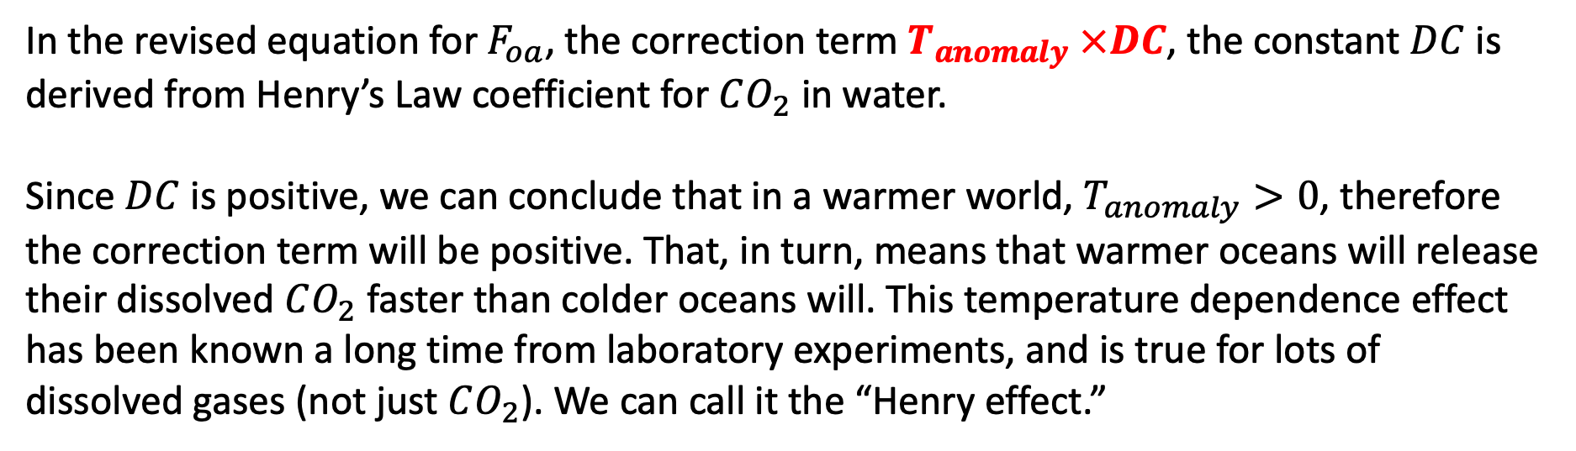
Equation 5’ represents the idea that ocean-to-atmosphere flux depends on temperature
In the revised equation for $F_{oa}$, the correction term $T_{anomaly} ×DC$, the constant $DC$ is derived from Henry’s Law coefficient for $CO_{2}$ in water.
Since $DC$ is positive, we can conclude that in a warmer world, $T_{anomaly}>0$, therefore the correction term will be positive. That, in turn, means that warmer oceans will release their dissolved $CO_{2}$ faster than colder oceans will. This temperature dependence effect has been known a long time from laboratory experiments, and is true for lots of dissolved gases (not just $CO_{2}$). We can call it the “Henry effect.”

Slide 15
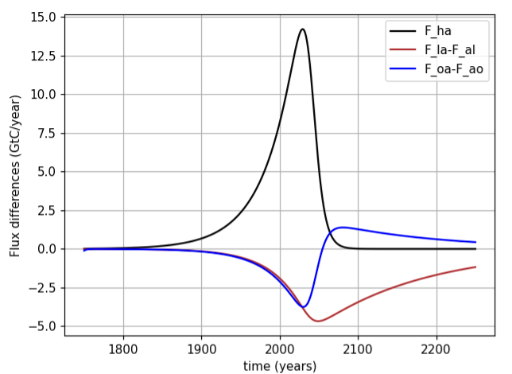
When you go to interpret your results, it’ll be interesting to note the extent of ecosystem services
In the year 2023, it looks like net fluxes to land and oceans were about ¼ of anthropogenic flux to atmosphere. We can say that the sum of these sinks (about ½ of anthropogenic flux) is Earth’s ”free” ecosystem service.

Slide 16
When you go to interpret your results, it’ll be interesting to note the extent of ecosystem services
Oceans become a net source of carbon around mid-century
Peak net ocean-to-atmosphere flux
The year oceans become net sources of carbon is the year they are no longer performing their ecosystem service. That year will be different for different model assumptions, of course!

